Slide 1



Bringing the HEAT Dataverse + Power BI Create real-time and contextualized analytics and reports in your apps
Scott Sewell
Principal Program Manager
Power BI Customer Advisory Team (PBICAT)

Slide 2




Thanks to our sponsors:
September 2022

Slide 5
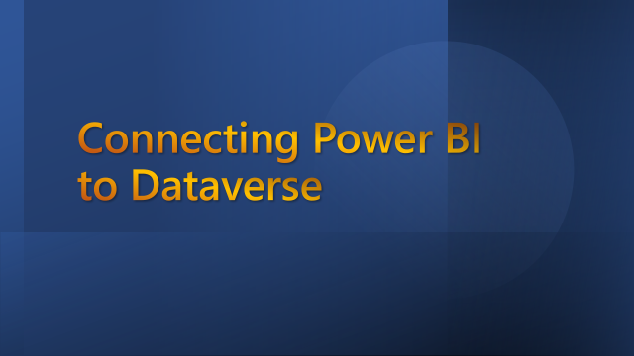
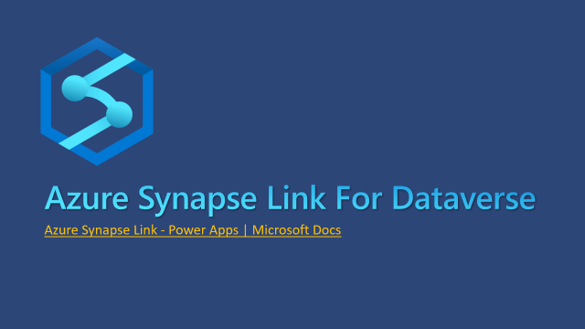
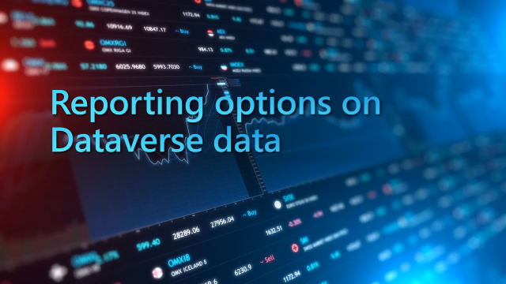

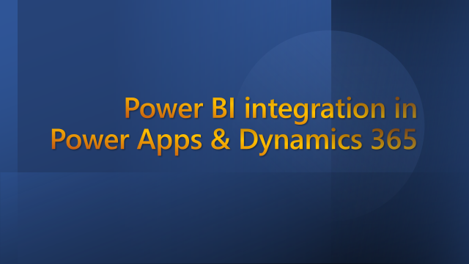

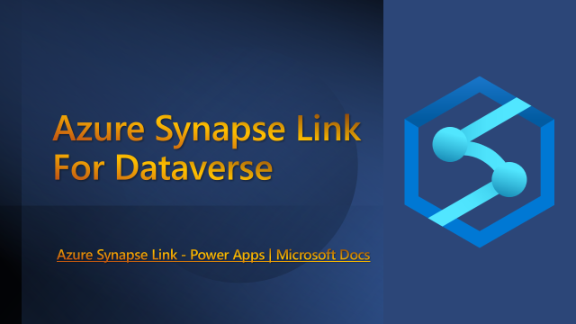
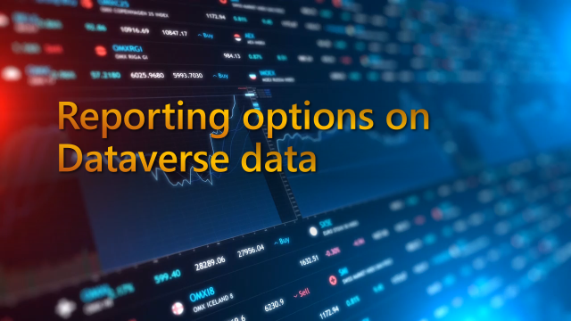
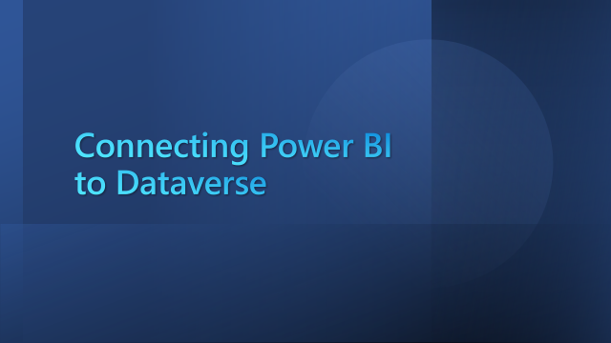

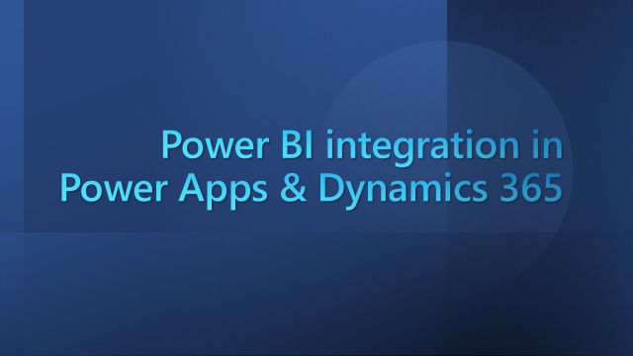

Dataverse + Power BI Comprehensive analytics and contextualized reports in your apps

Slide 6
Power BI integration in Power Apps & Dynamics 365

Slide 7
Let’s talk Value:
Expand the usability and value of your apps
Add a 360º overview for users / managers
Dataverse data – Without 50K row limits
External data – Combine without lift-and-shift
Contextual Reports
360º View from within an individual record
Finally – The real benefit:
Power BI is the best way to expose the value of the data in your app to Business Decision Makers
Increase speed and completeness of adoption
Built-in Artificial Intelligence over your data

Slide 8
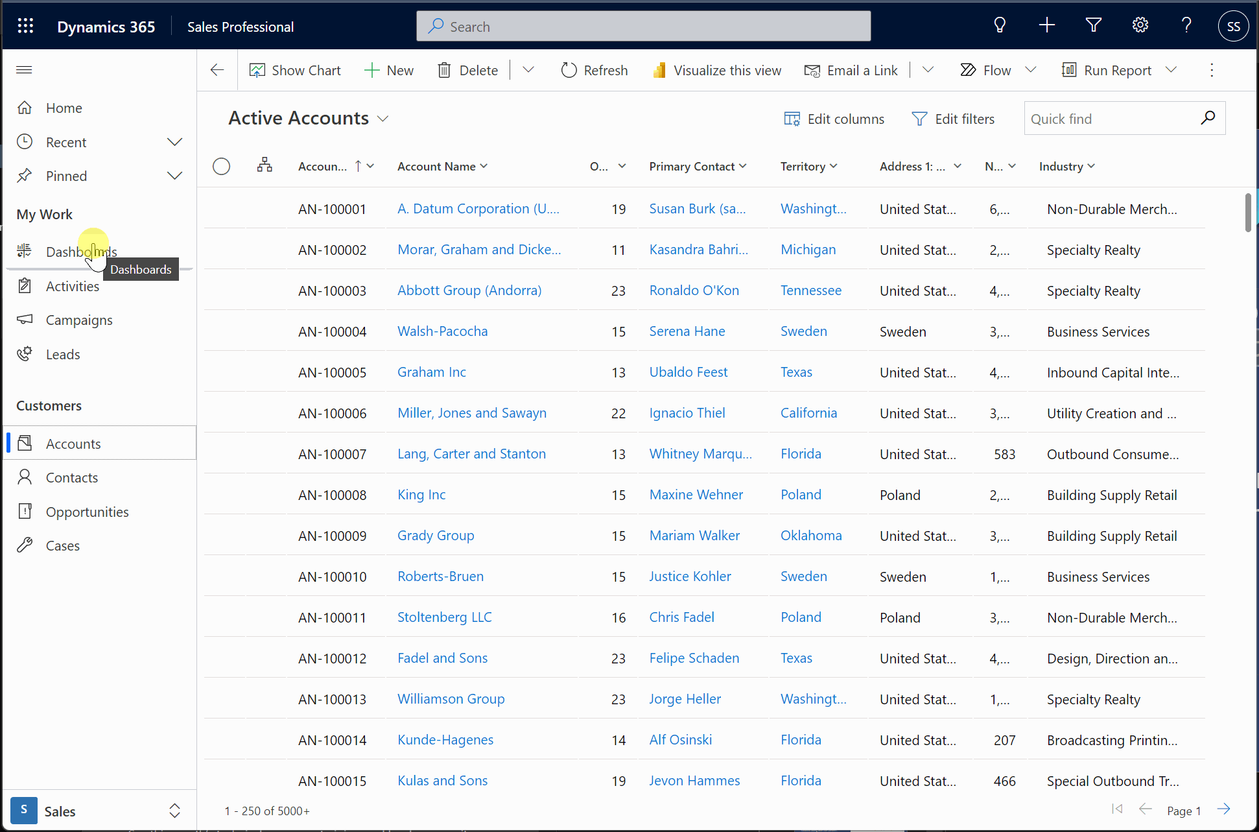
Displaying a Power BI report in a dashboard
Welcome your app users with advanced insights.
Act on the insights in the report as you navigate to drive results.

Slide 9
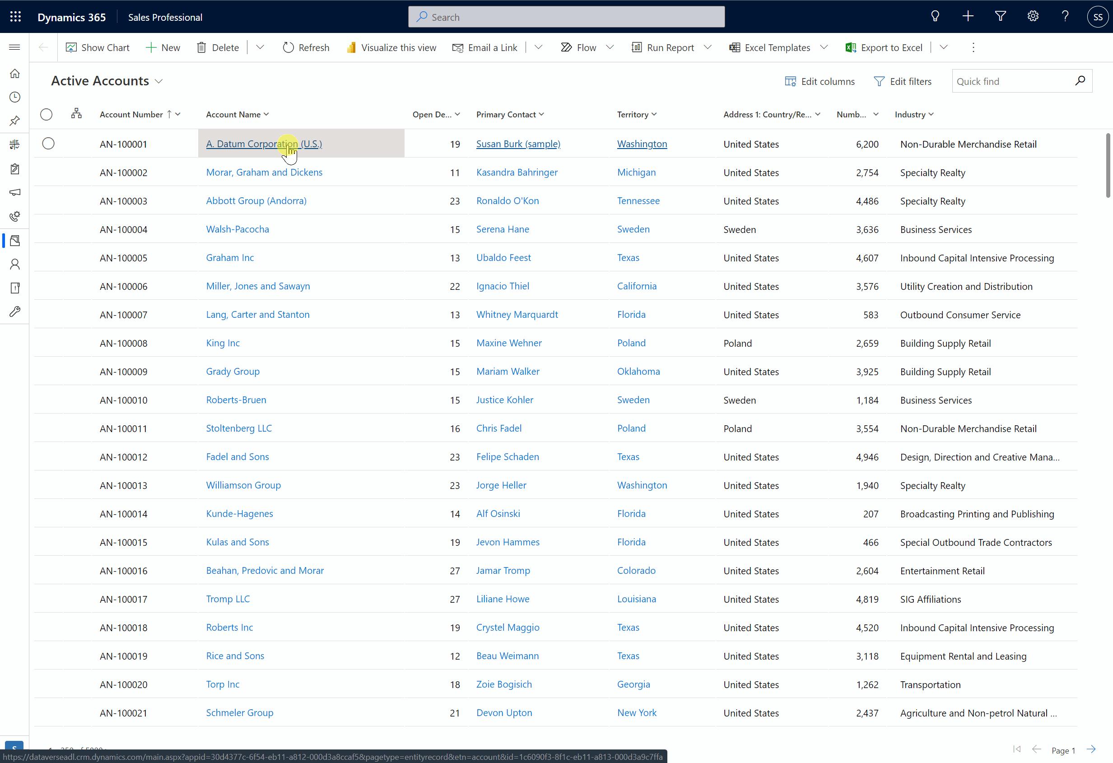
Displaying a Power BI report in a main form
Reports in forms can be contextualized to the record, offering a 360 view.
Multiple data sources can be used to visualize data beyond what is stored in Dataverse.

Slide 10
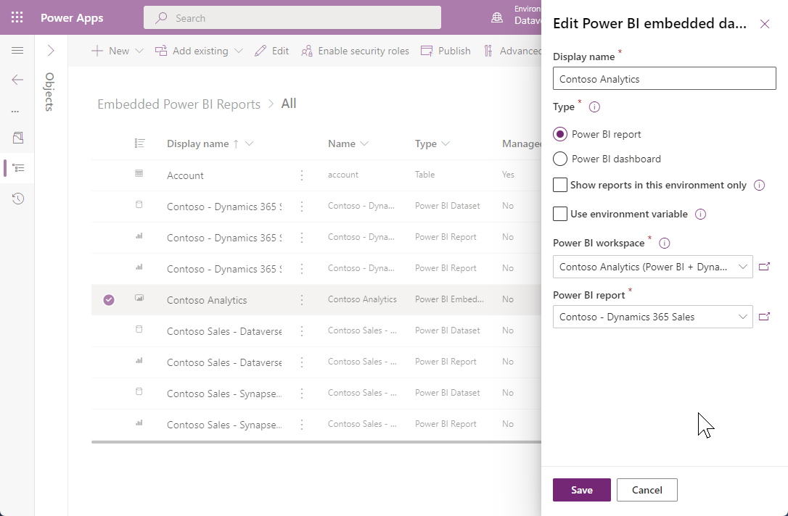
Embedding a Power BI report into a dashboard
Official documentation:
Create or edit a Power BI embedded system dashboard
Use environment variables to point to different Power BI workspaces and reports in dev/test/prod etc.

Slide 11
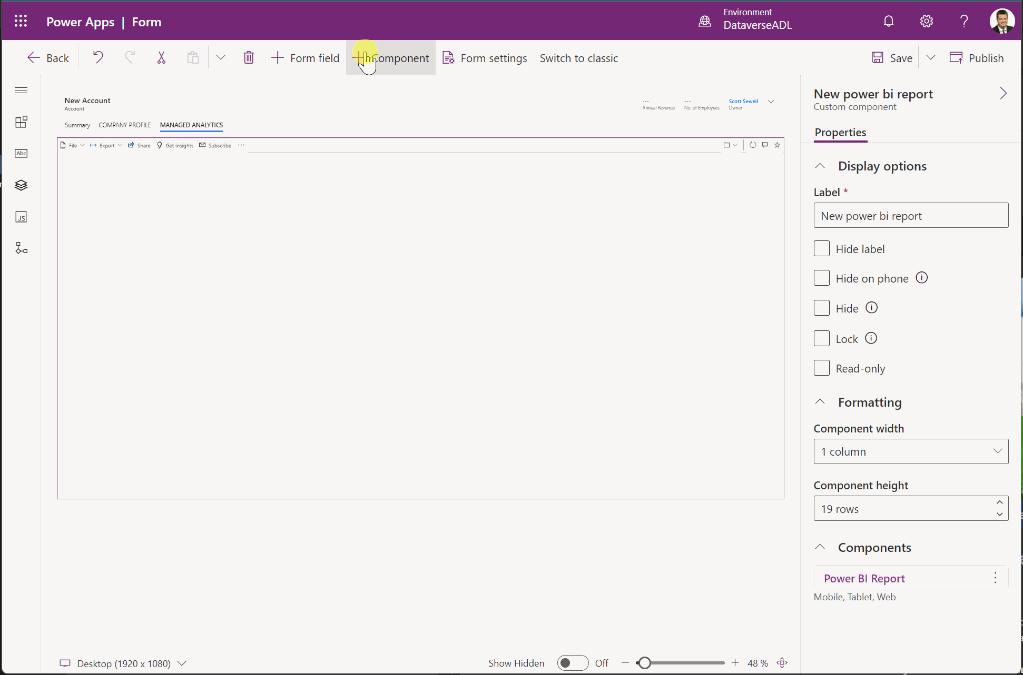
Embedding a Power BI report into a form
New embedding experience! PCF-based control to embed a solution-managed report in a model driven form. Can enable / disable:
Filter Pane
Tabs
Action Bar
Background
Bookmarks

Slide 12
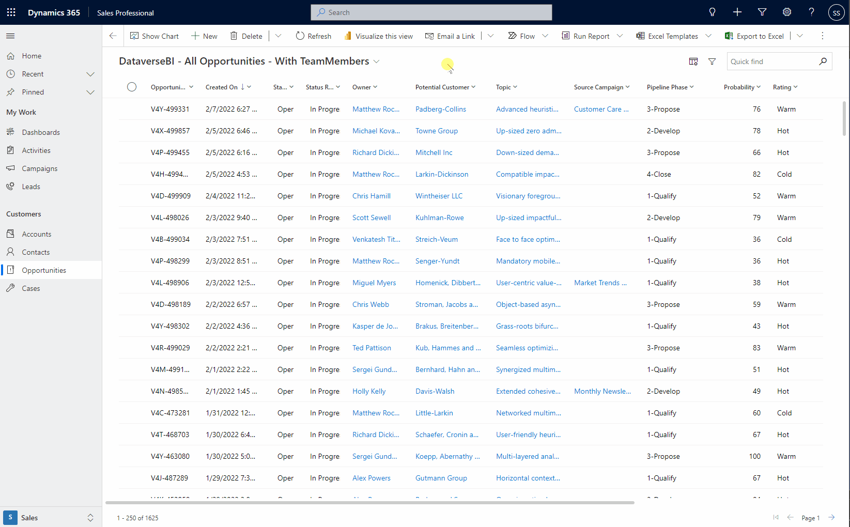
Power BI Quick Reports in Dataverse Views
Create a Power BI report from within a Dataverse View.
Report can be customized and saved
Enabled ‘per app’ in Maker Portal

Slide 13
Power BI in Power Apps & Dynamics 365
Platform | Component | Power BI Report | Power BI Dashboard | Power BI Dashboard Tile
Power Apps | System dashboard | ✅ | ✅ | ❌
 | Personal dashboard | ❌ | ✅ | ✅
 | Main form | ✅ | ❌ | ✅
 | Custom page (Coming Soon) | ❌ | ❌ | ❌
 | Canvas app | ✅ | ❌ | ✅
 | Portal | ✅ | ✅ | ✅
Power Apps and Power Automate in Power BI
Power BI | Power Apps canvas app | Power Automate cloud flow
Report visual | ✅ | ✅

Slide 14
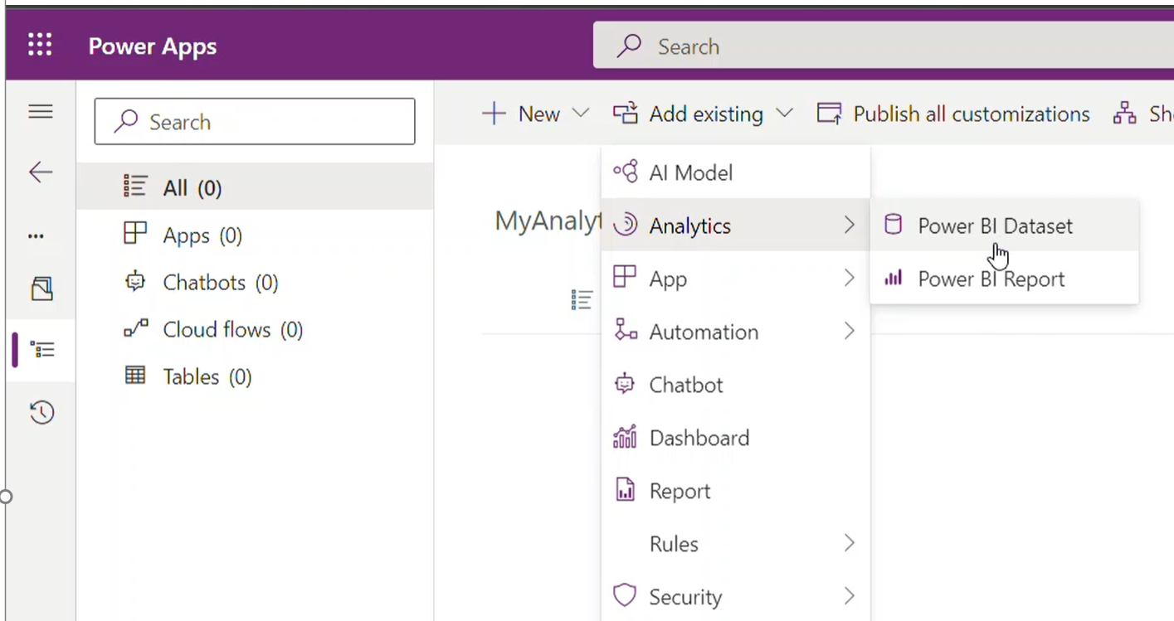
Solution Aware Power BI in Power Apps Solutions
Ship Power BI content in a Power Apps Solutions across environments & tenants.
Add to Solution.
Makers can add Power BI content to a solution along with the content.
One Click Deployment
Importing a Power Apps Solution deploys content to dedicated environment workspace in Power BI.
Customization
Customize Power BI content with ease to fit the organization/department analytics needs.

Slide 15
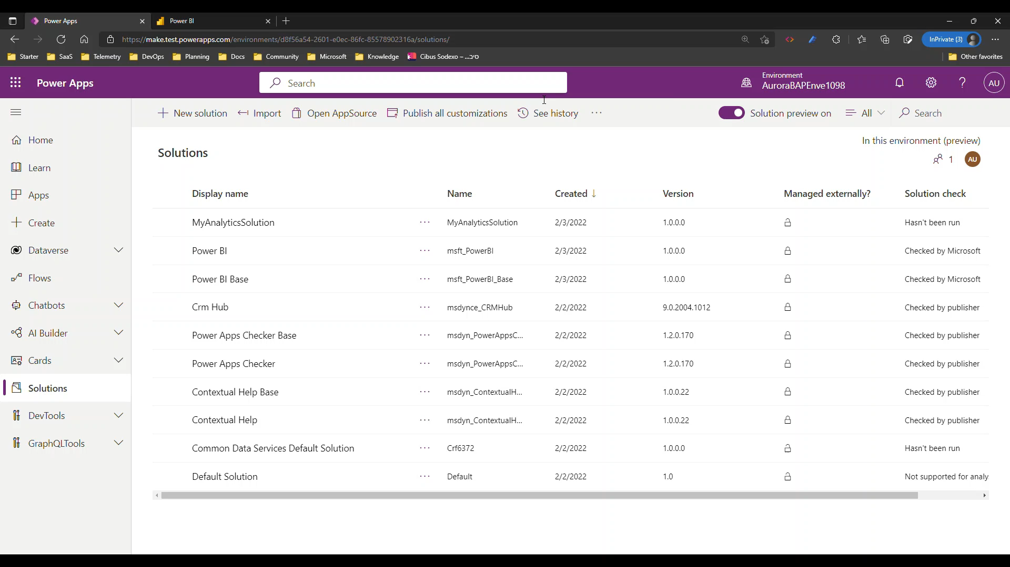
Solution Aware Power BI in Power Apps Solutions
Ship Power BI content in a Power Apps Solutions across environments & tenants.

Slide 16

Reporting options on Dataverse data

Slide 17


Reporting options on Dataverse data
DirectQuery using Dataverse Connector
Individual user’s own data (security model applies)
Best for targeted datasets <50K rows returned
Import Mode using Dataverse Connector
Scheduled refreshes of medium-sized datasets <100K rows returned
Faster rendering/responsiveness of reports
Azure Synapse Link for Dataverse
Enterprise-Scale data source for reporting
Incremental refresh is possible if carefully managed
Enrichment through Machine Learning
Run-time query for current data – real-time-ish
Integration with Data Warehouse
Power BI DataMart (preview)
Power Query ETL into a SQL database
Combine with other sources to create a rich Data Source for Reporting

Slide 18

Reporting options on Dataverse data
1) DirectQuery using Dataverse Connector
DirectQuery using Dataverse Connector
Best for targeted datasets <50K rows returned
Run-time query for current data – near-real-time
Individual user’s own data (security model applies)

Slide 19
Reporting options on Dataverse data
2) Import mode using Dataverse Connector
Import Mode using Dataverse Connector
Faster rendering/responsiveness of reports
Scheduled refreshes of medium-sized datasets <100K rows returned
Incremental refresh is possible if carefully managed
This Photo by Unknown Author is licensed under CC BY-SA

Slide 20
Reporting options on Dataverse data
3) Import from Synapse Analytics SQL
Azure Synapse Link for Dataverse
Enterprise-Scale data source for reporting
Enrichment through Machine Learning
Integration with Data Warehouse
This Photo by Unknown Author is licensed under CC BY-SA

Slide 21
Reporting options on Dataverse data
1) Direct Query using Dataverse Connector
2) Import mode using Dataverse Connector
3) Import from Synapse Analytics SQL
1) Dataverse + DirectQuery
Individual user’s own data (security model applies)
Best for targeted datasets <50K rows returned
2) Dataverse + Import Mode
Scheduled refreshes of medium-sized datasets <100K rows returned
Faster rendering/responsiveness of reports
3) Azure Synapse Link for Dataverse
Enterprise-Scale data source for reporting
Incremental refresh is possible if carefully managed
Enrichment through Machine Learning
Run-time query for current data – real-time-ish
Integration with Data Warehouse
This Photo by Unknown Author is licensed under CC BY-SA

Slide 22
Connecting Power BI to Dataverse

Slide 23
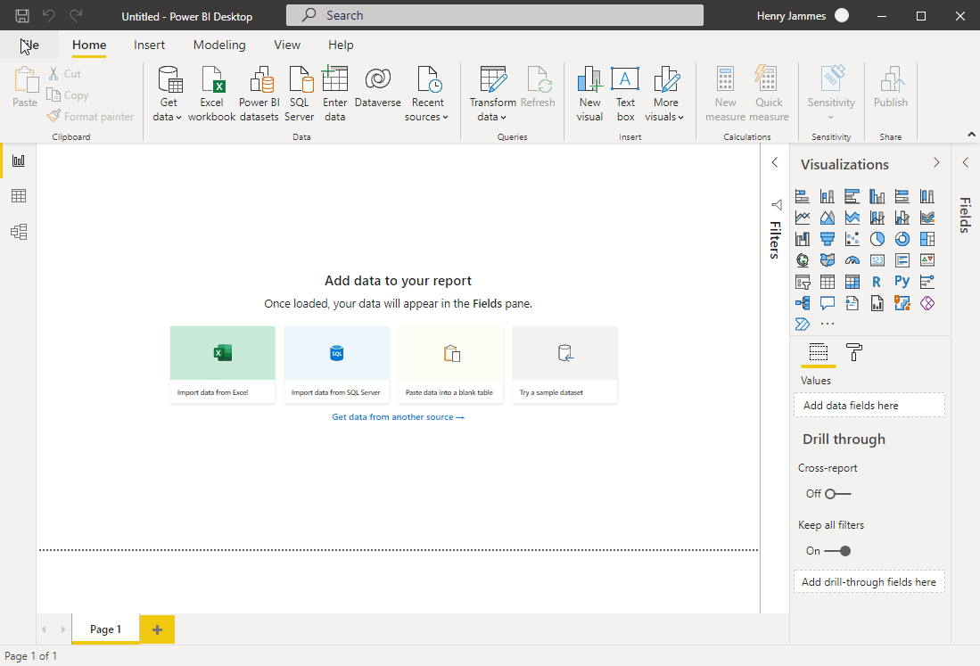
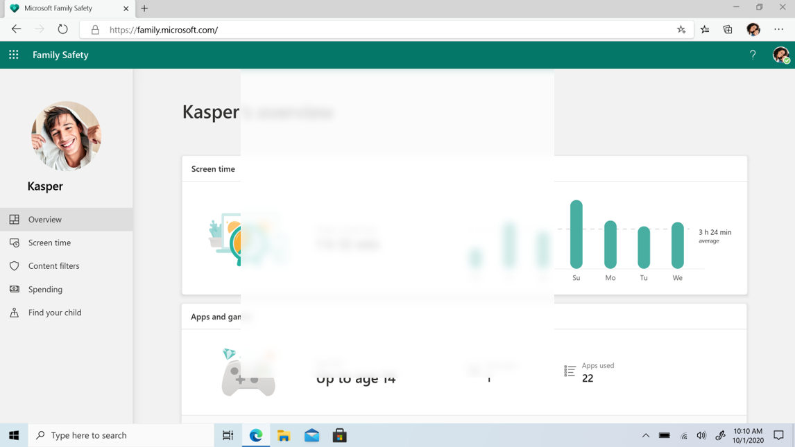
Dataverse connector in Power BI
Easiest way to get started for citizen report makers, thanks to the environment picker.
Important to transform data in Power Query to remove all unnecessary columns and filter your data.
Verify query folding, to optimize performance.

Slide 24
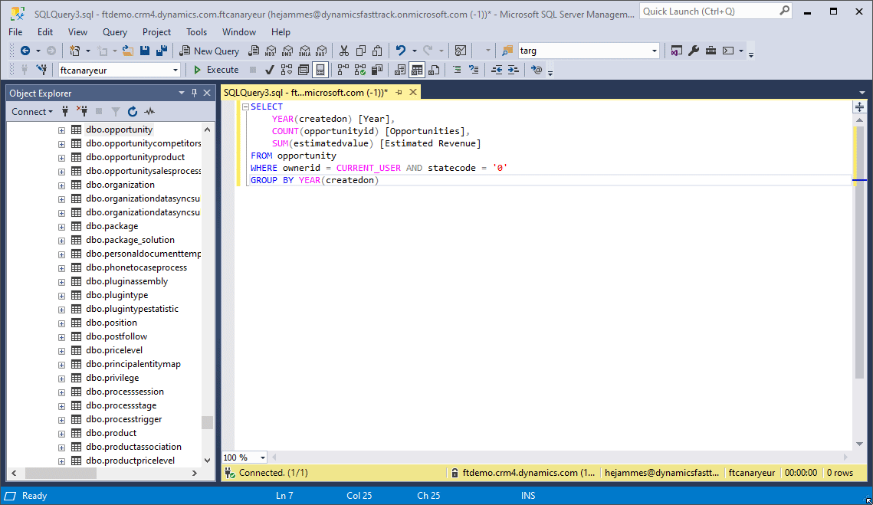
Creating Dataverse SQL-based Power BI reports
Fast and ideal for report makers who prefer SQL as a query language.
Datasets can be prepared with aggregates, joins and filters.
Use the CURRENT_USER variable to replicate the “My …” (Accounts, etc.) filtered views.

Slide 25

DirectQuery Best Practices
Stay focused on use case
Embrace a Star Schema
Minimize query columns
Leverage the Query Editor
Take advantage of the hints
Avoid large blocks of text
Minimize choice labels
Consider dual-mode dims
Ensure the Query is Folding
Don’t forget the checkbox
What topic area is this report supporting?
Who is the audience of this report?
What question is the report trying to answer?
What’s the MVD - Minimum Viable Dataset?

Slide 26


DirectQuery Best Practices
Stay focused on use case
Embrace a Star Schema
Minimize query columns
Leverage the Query Editor
Take advantage of the hints
Avoid large blocks of text
Minimize choice labels
Consider dual-mode dims
Ensure the Query is Folding
Don’t forget the checkbox

Slide 27
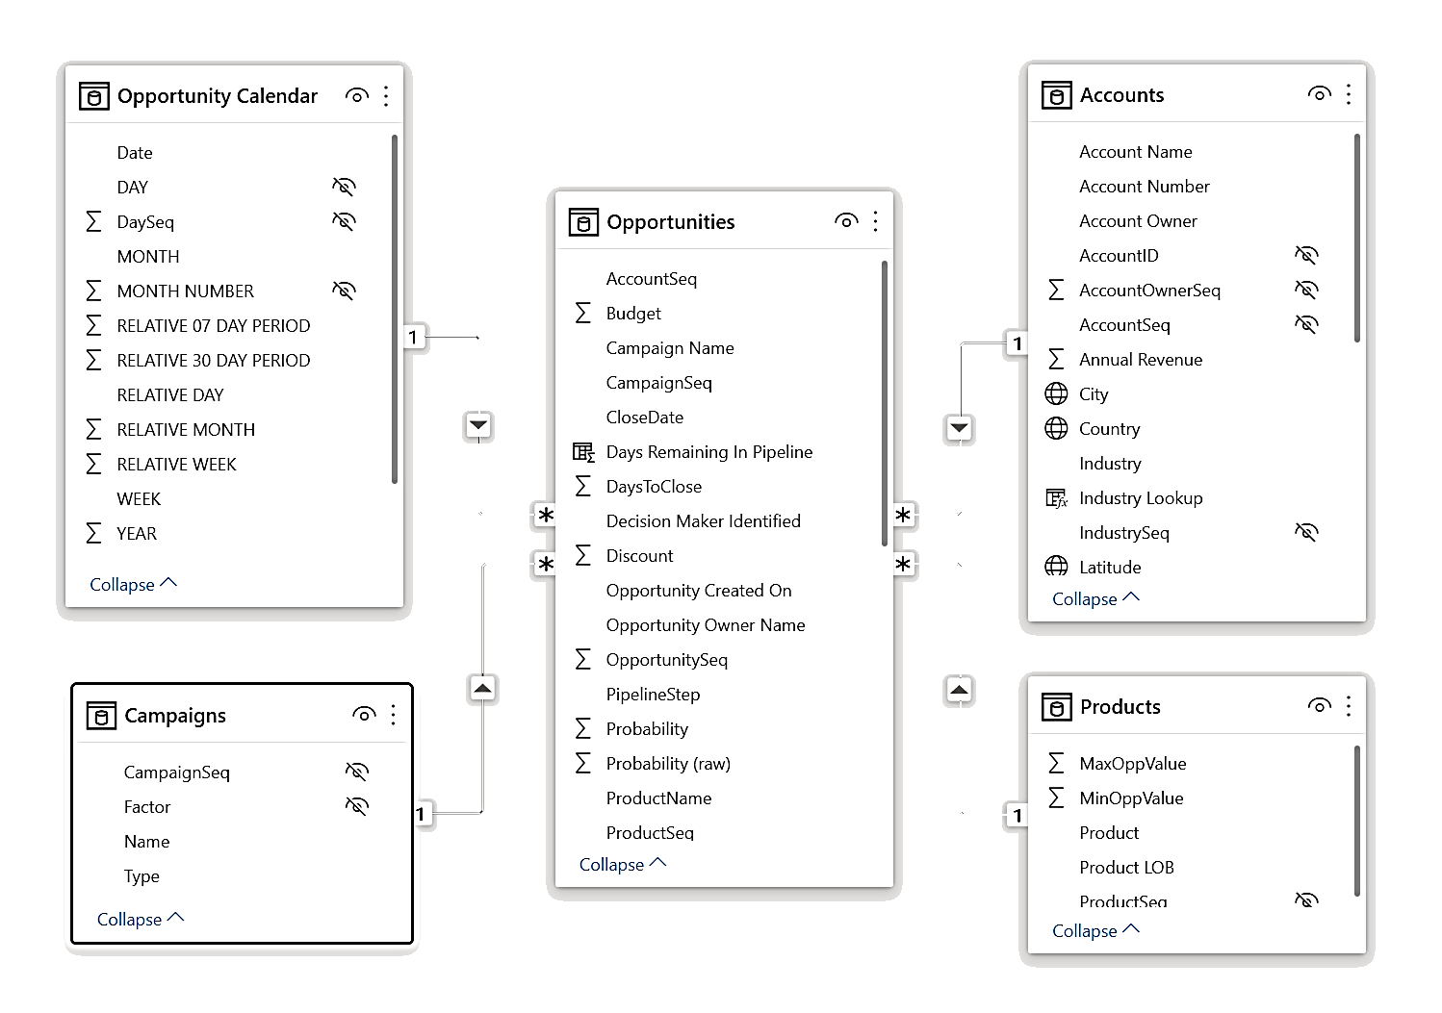





DirectQuery Best Practices
Stay focused on use case
Embrace a Star Schema
Minimize query columns
Leverage the Query Editor
Take advantage of the hints
Avoid large blocks of text
Minimize choice labels
Consider dual-mode dims
Ensure the Query is Folding
Don’t forget the checkbox
Dimension
Dimension
FACT
Dimension
Dimension
Understand star schema and the importance for Power BI

Slide 28
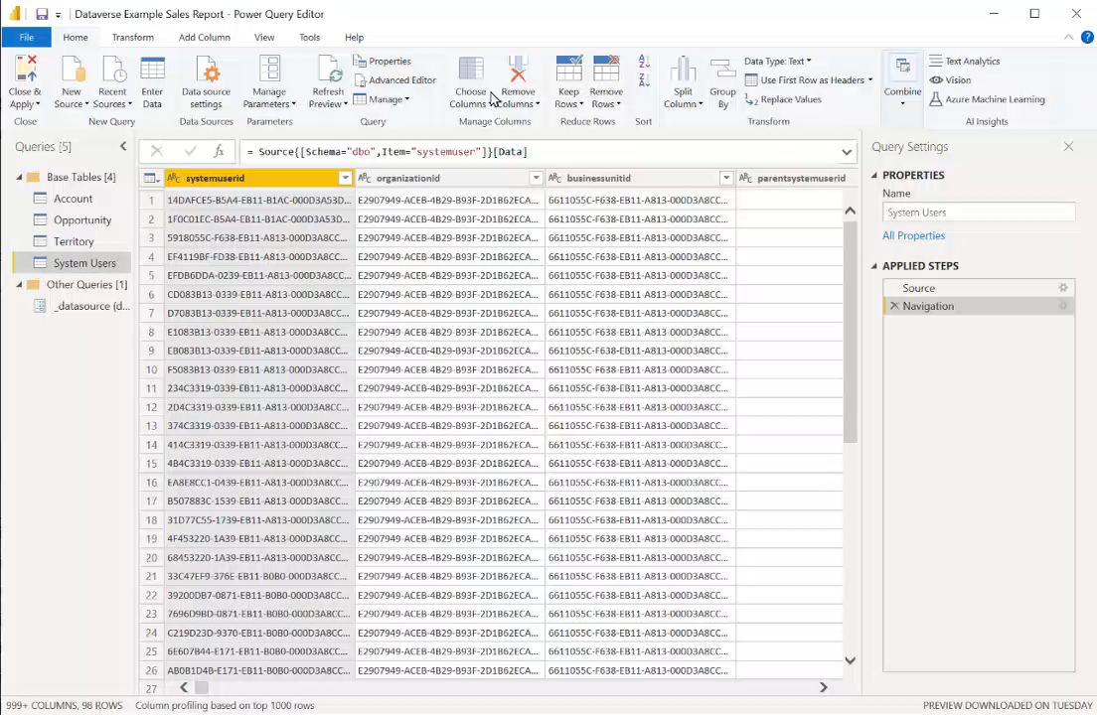
DirectQuery Best Practices
Stay focused on use case
Embrace a Star Schema
Minimize query columns
Leverage the Query Editor
Take advantage of the hints
Avoid large blocks of text
Minimize choice labels
Consider dual-mode dims
Ensure the Query is Folding
Don’t forget the checkbox

Slide 29
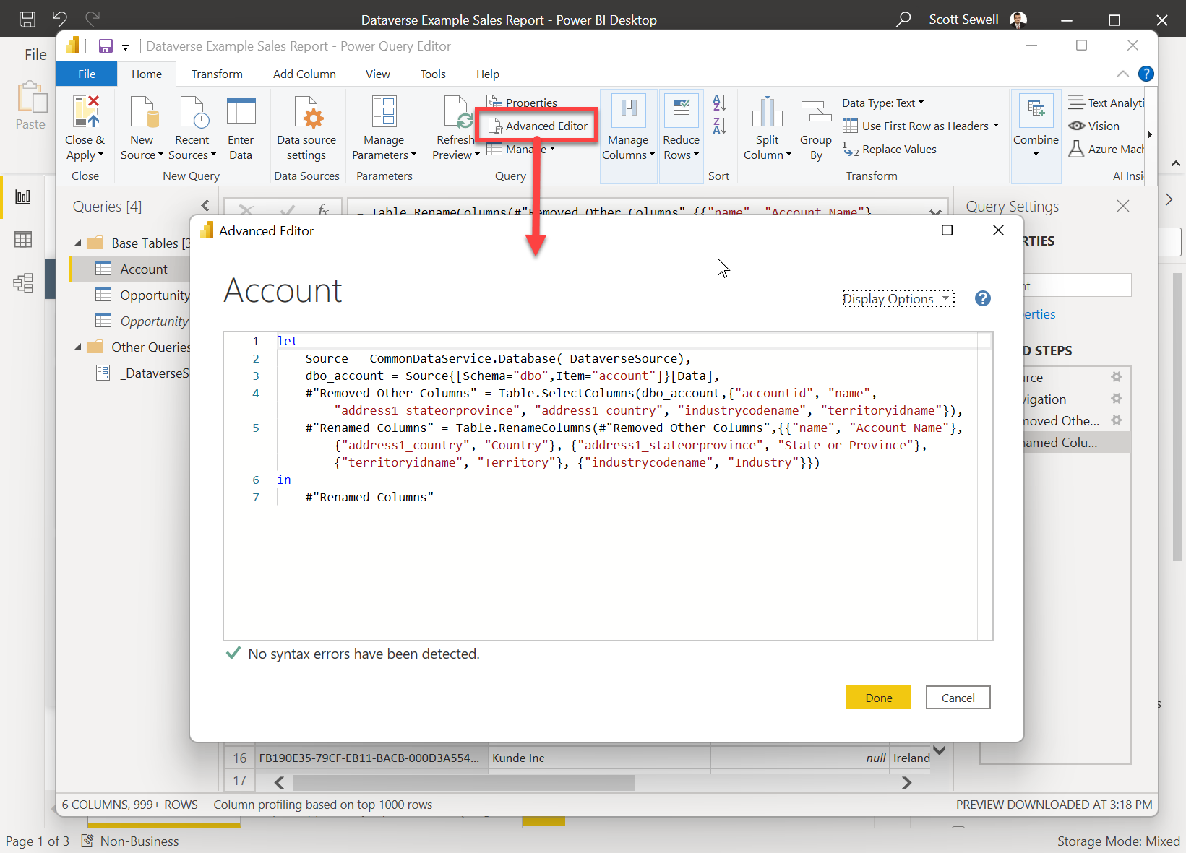
DirectQuery Best Practices
Stay focused on use case
Embrace a Star Schema
Minimize query columns
Leverage the Query Editor
Take advantage of the hints
Avoid large blocks of text
Minimize choice labels
Consider dual-mode dims
Ensure the Query is Folding
Don’t forget the checkbox
With large tables, build the query in the Query Editor. A simple query will get you started and allow you to build up the query quickly and ‘safely’.

Slide 30
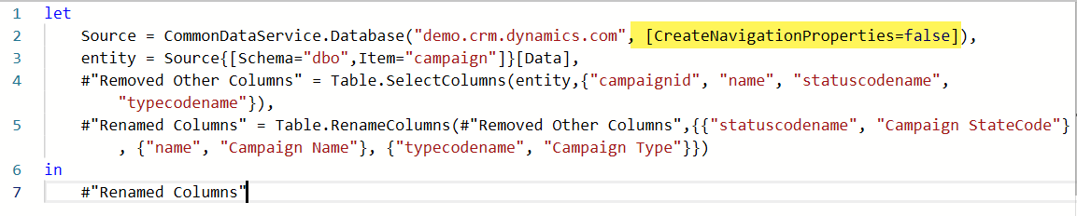
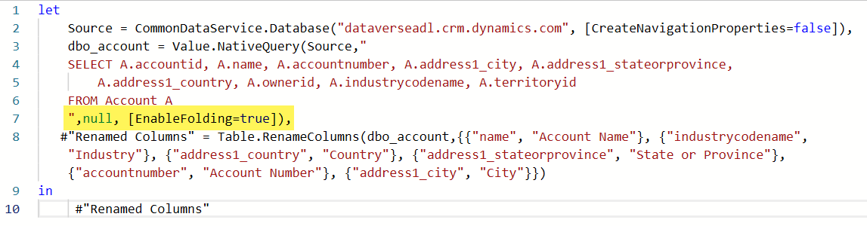
DirectQuery Best Practices
Add the hint "[CreateNavigationProperties=false]" to ignore the table's relationship metadata from Dataverse.
This can dramatically speed up report load times in the editor.
Stay focused on use case
Embrace a Star Schema
Minimize query columns
Leverage the Query Editor
Take advantage of the hints
Avoid large blocks of text
Minimize choice labels
Consider dual-mode dims
Ensure the Query is Folding
Don’t forget the checkbox
If you’re using a native query against Dataverse, add the ‘EnableFolding=true’ hint to allow Power Query to off-load more of the processing and filtering work to Dataverse and improve refresh times.

Slide 31
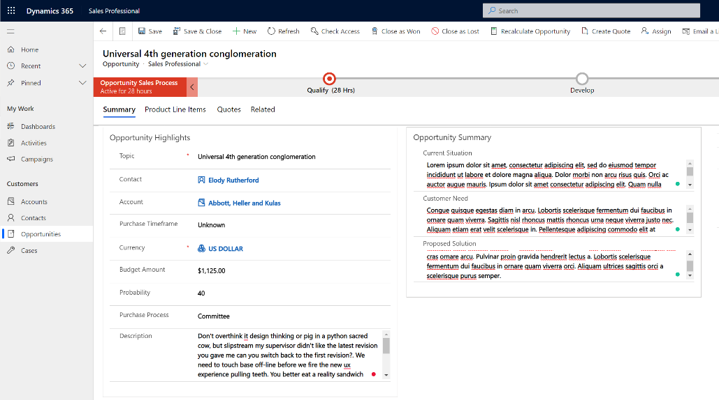


DirectQuery Best Practices
Stay focused on use case
Embrace a Star Schema
Minimize query columns
Leverage the Query Editor
Take advantage of the hints
Avoid large blocks of text
Minimize choice labels
Consider dual-mode dims
Ensure the Query is Folding
Don’t forget the checkbox

Slide 32
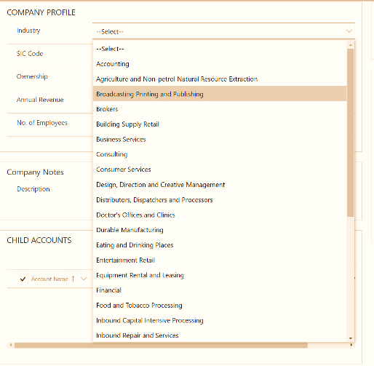

DirectQuery Best Practices
Whenever possible, filter the dataset on the numeric value of a choice column, rather than the string.
Normally a few choices are fine, but if there are a dozen or more being pulled in the query, consider returning only the integer value from Dataverse and using a calculated field to apply the label inside Power BI. – This improves speed and reduces the overall size of the query results.
Stay focused on use case
Embrace a Star Schema
Minimize query columns
Leverage the Query Editor
Take advantage of the hints
Avoid large blocks of text
Minimize choice labels
Consider dual-mode dims
Ensure the Query is Folding
Don’t forget the checkbox

Slide 33
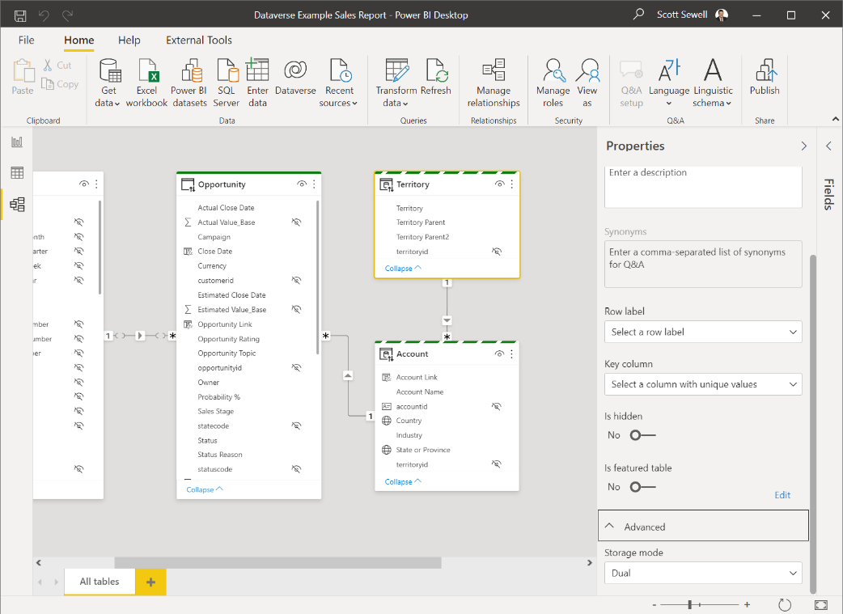
DirectQuery Best Practices
Stay focused on use case
Embrace a Star Schema
Minimize query columns
Leverage the Query Editor
Take advantage of the hints
Avoid large blocks of text
Minimize choice labels
Consider dual-mode dims
Ensure the Query is Folding
Don’t forget the checkbox

Slide 34
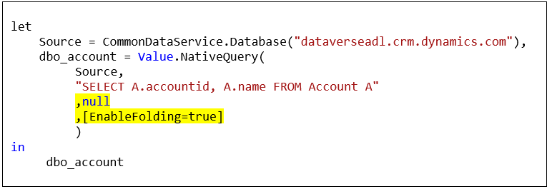
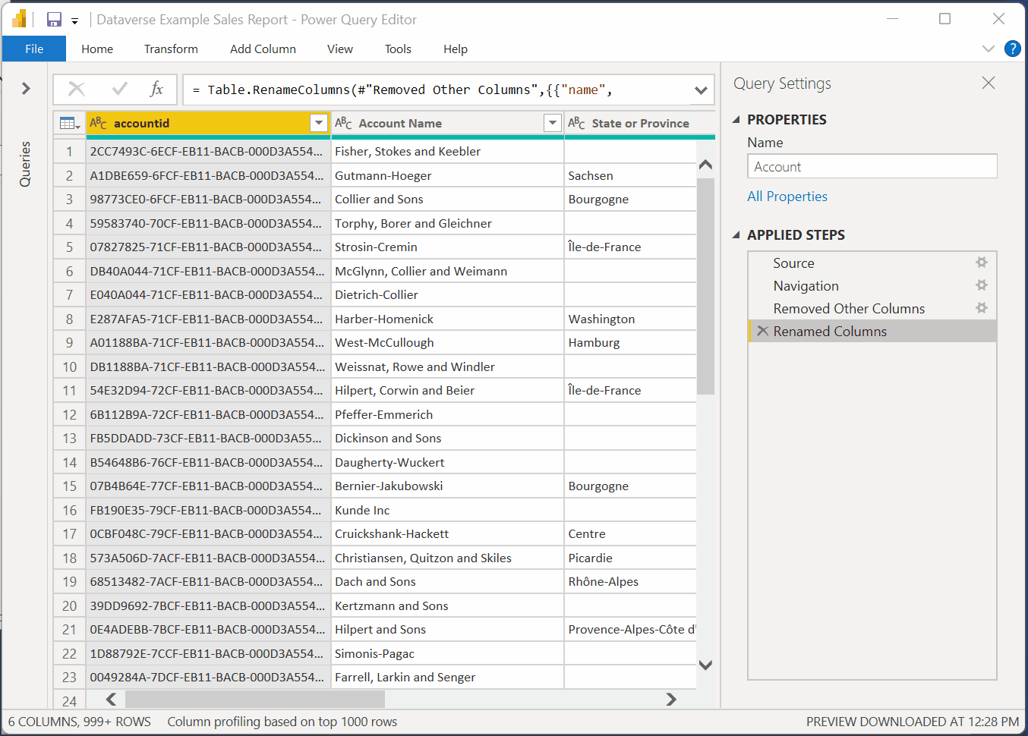
DirectQuery Best Practices
Stay focused on use case
Embrace a Star Schema
Minimize query columns
Leverage the Query Editor
Take advantage of the hints
Avoid large blocks of text
Minimize choice labels
Consider dual-mode dims
Ensure the Query is Folding
Don’t forget the checkbox
If you’re using a native query, add the ‘EnableFolding=true’ hint.
https://docs.microsoft.com/en-us/power-query/power-query-folding

Slide 35
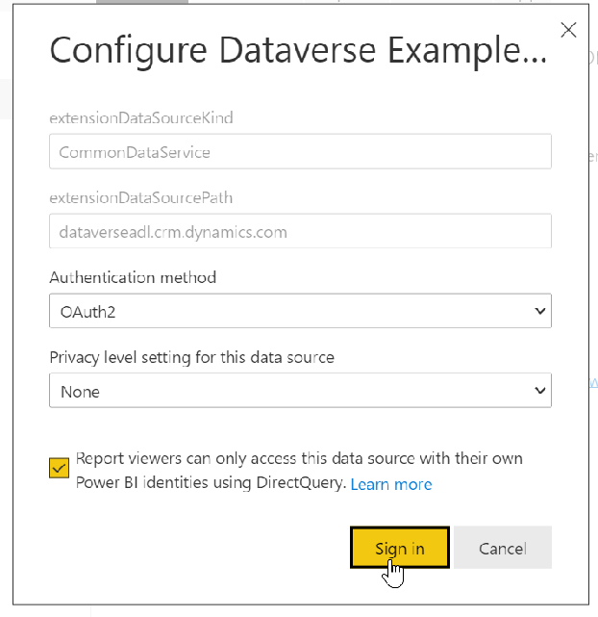
DirectQuery Best Practices
Stay focused on use case
Embrace a Star Schema
Minimize query columns
Leverage the Query Editor
Take advantage of the hints
Avoid large blocks of text
Minimize choice labels
Consider dual-mode dims
Ensure the Query is Folding
Don’t forget the checkbox
After Publishing the Report, you’ll need to set up the credentials for the dataset.
Be sure to click the checkbox to ensure report viewers will see the report filtered to the data they have permission to see within Dataverse.

Slide 36
Dataverse connector in Power Query
Benefits:
Available directly in Power BI (and Excel in a future release).
DirectQuery support
Real-time
User security context is applied
Dataverse SQL support
Considerations:
TDS endpoint limits apply
80-MB maximum for query results
Unsupported datatypes and tables (image, file, multi-choice, audit, etc.)
Dates are formatted as UTC.
Plug-ins registered on the RetrieveMultipleRequest or RetrieveRequest messages are not triggered
Import Mode Support
Highly responsive user interactions
Lowered complexity of query

Slide 37

Azure Synapse Link For Dataverse
Azure Synapse Link - Power Apps | Microsoft Docs

Slide 38
SQL Data Export Service
Effective November 2021, the SQL Data Export Service was deprecated.
Data Export Service will continue to work and will be fully supported until it reaches end-of-support and end-of-life in November 2022.
More information: https://aka.ms/DESDeprecationBlog

Slide 39
Azure Synapse Link for Dataverse
Azure Synapse Analytics
Auto-Created Views
Azure Synapse Link for Dataverse
Power BI
Azure Data Lake Storage

Slide 40
Azure Synapse Link for Dataverse
Azure Synapse Analytics
Auto-Created Views
Custom Report Views
Azure Synapse Link for Dataverse
Power BI
Azure Data Lake Storage

Slide 41
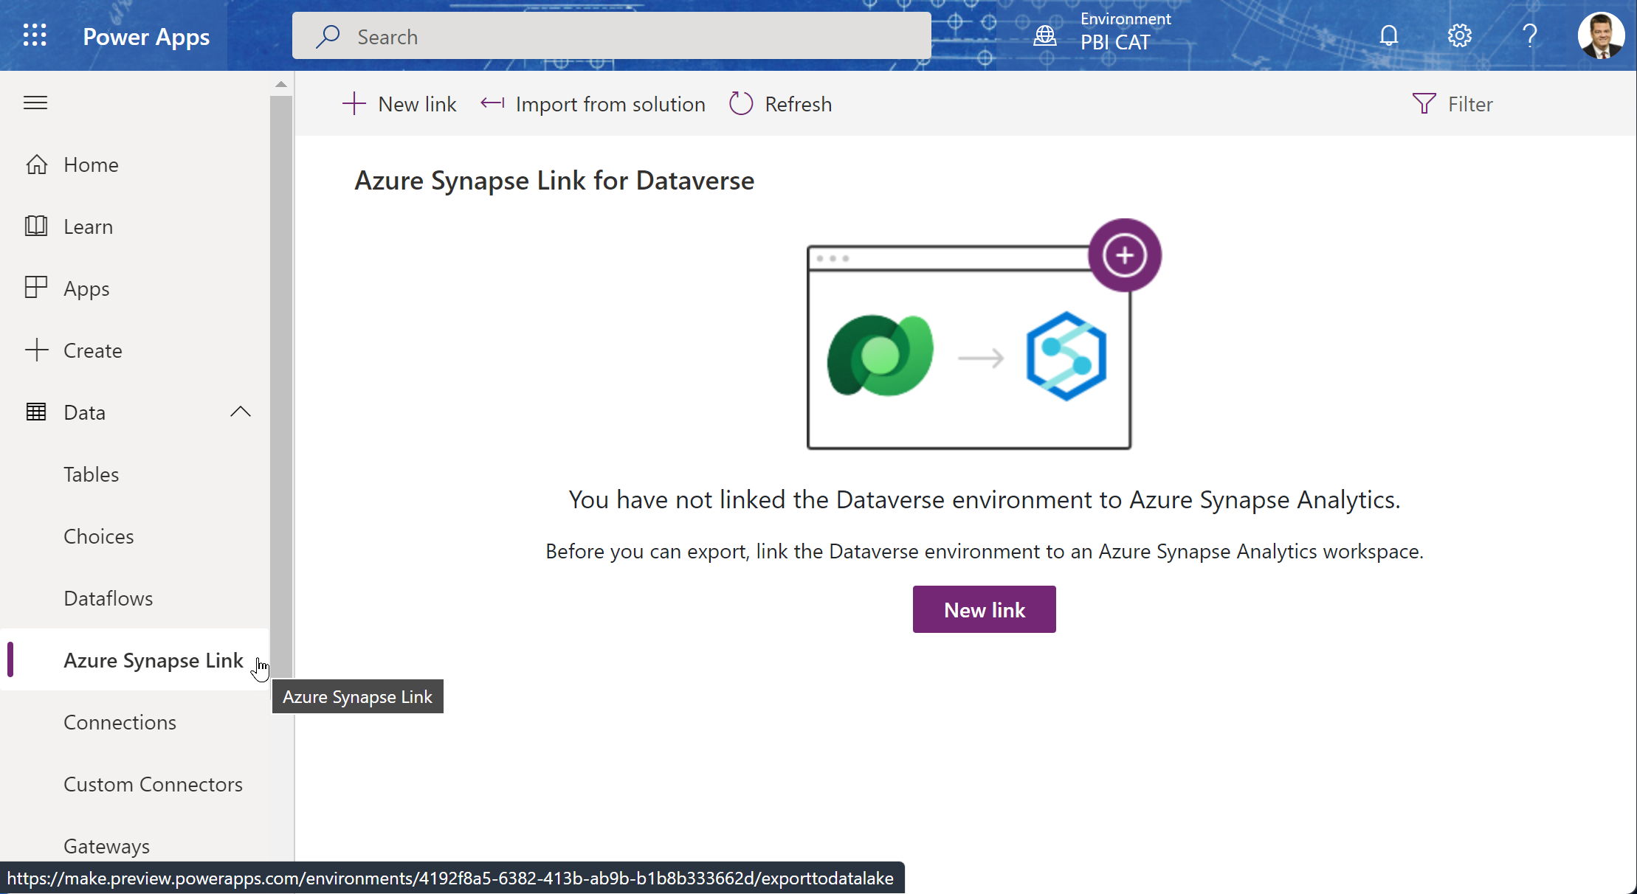
Setup of Synapse Link
Power Apps Administration Page
Https://make.PowerApps.Com

Slide 42
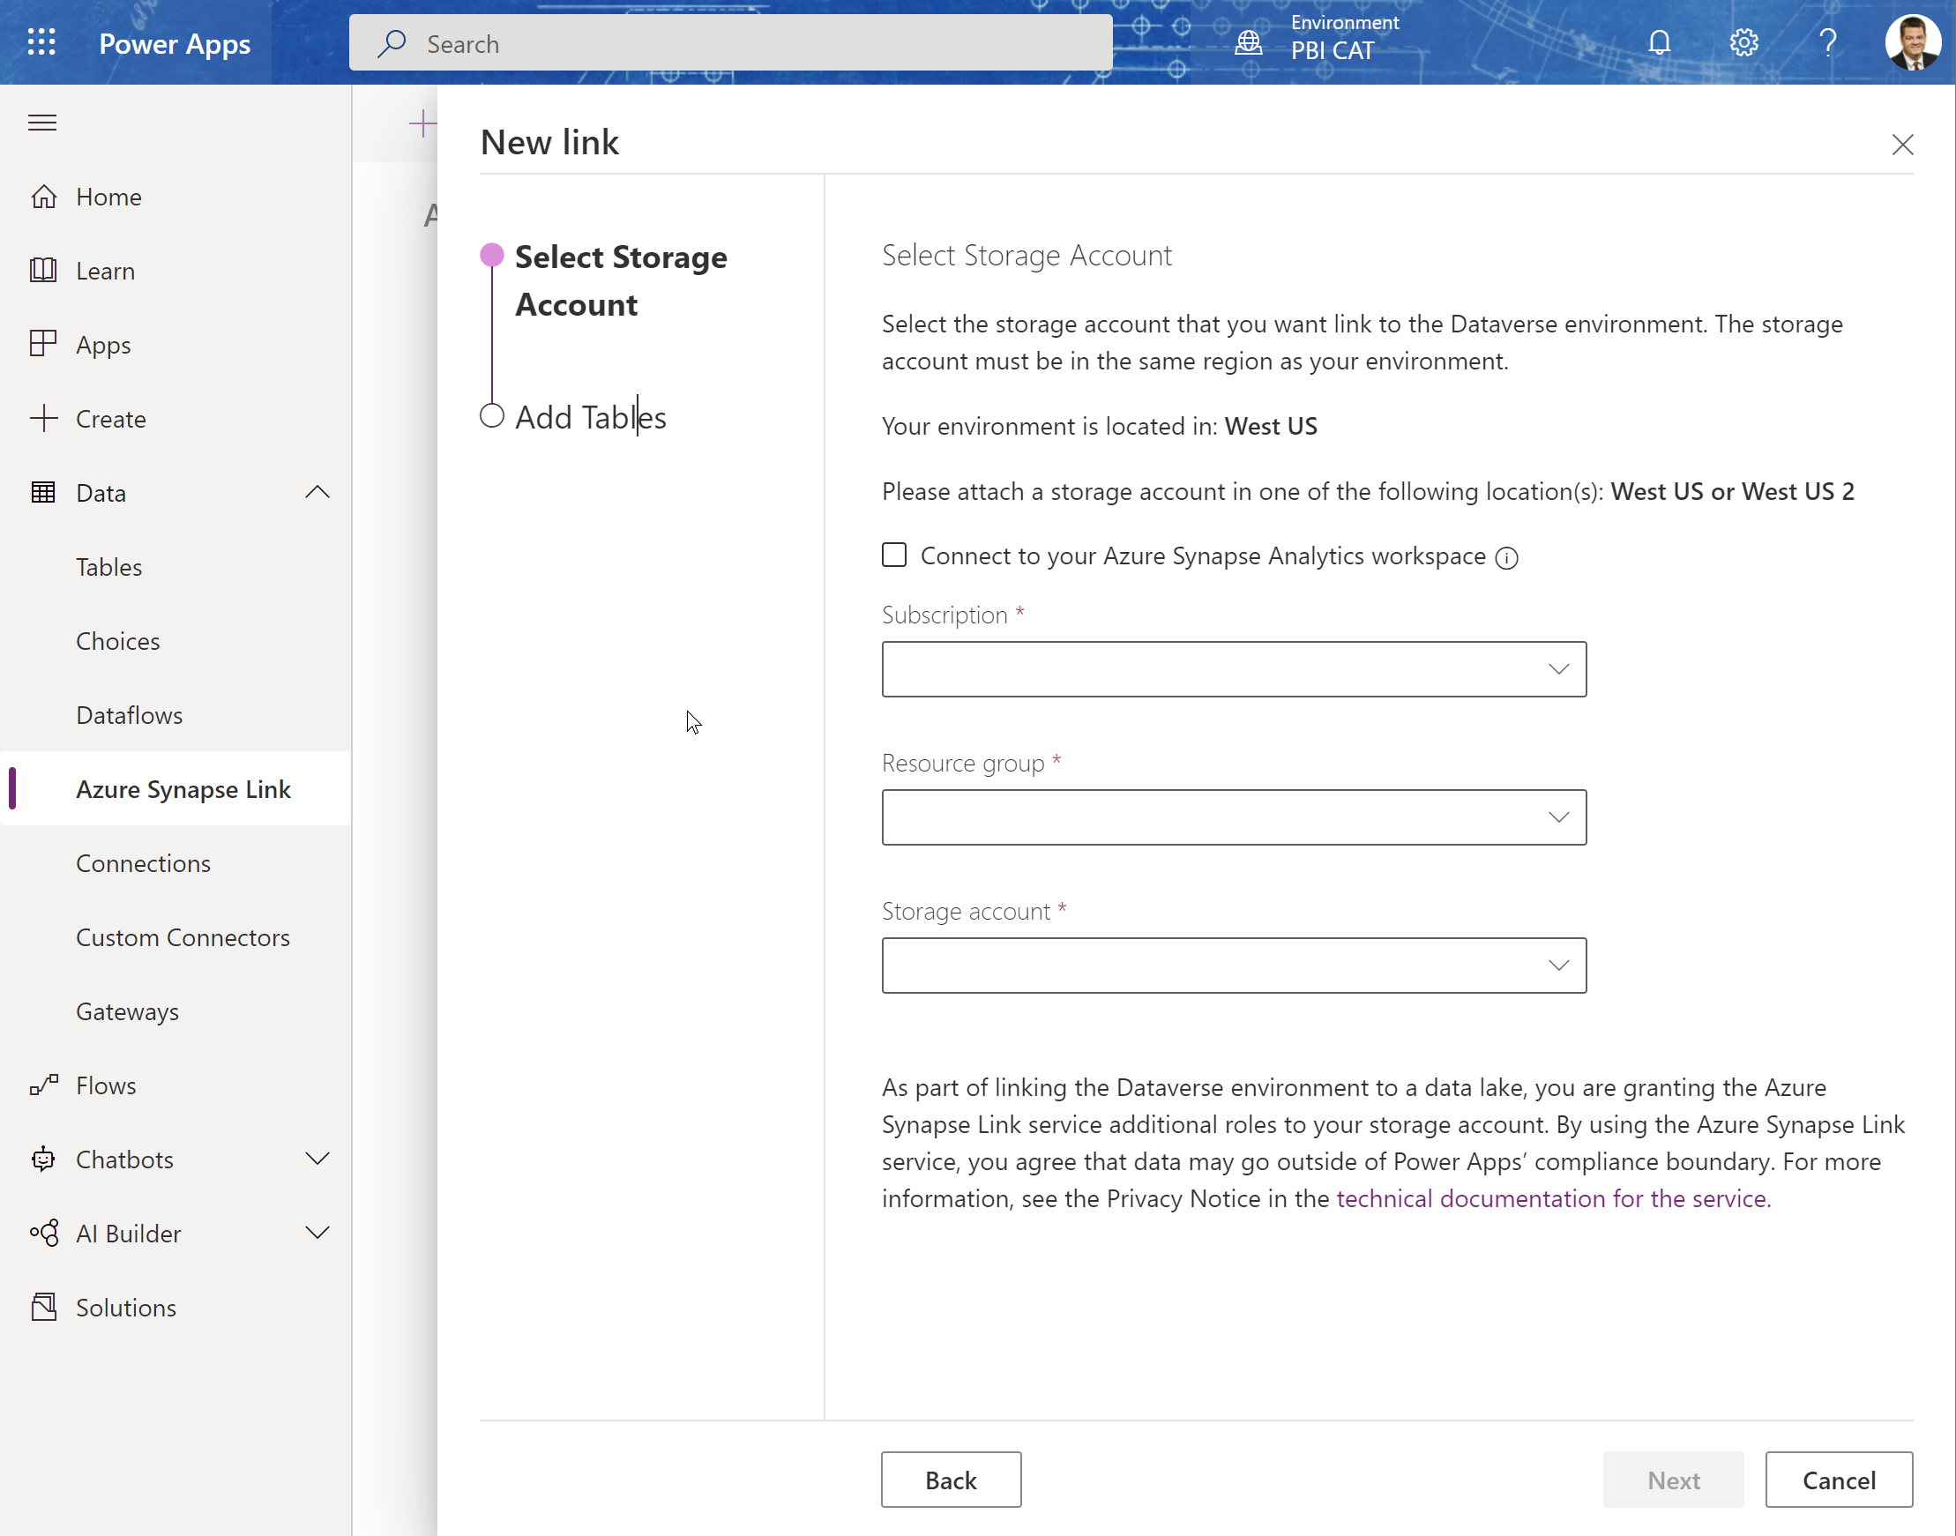
Create Synapse Link
Choose the Storage account and Synapse workspace:
If you already have a Synapse Workspace, click the checkbox to connect to the existing workspace.

Slide 43
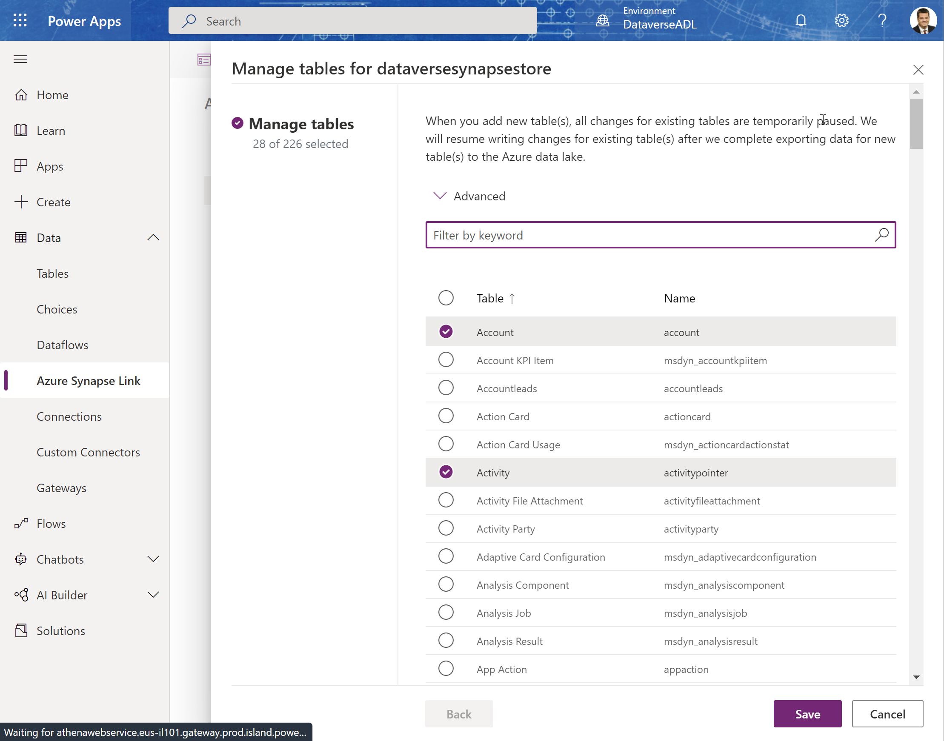
Choose Tables
Choose the tables you want to sync to the Azure data lake – (you can add more later.)

Slide 44
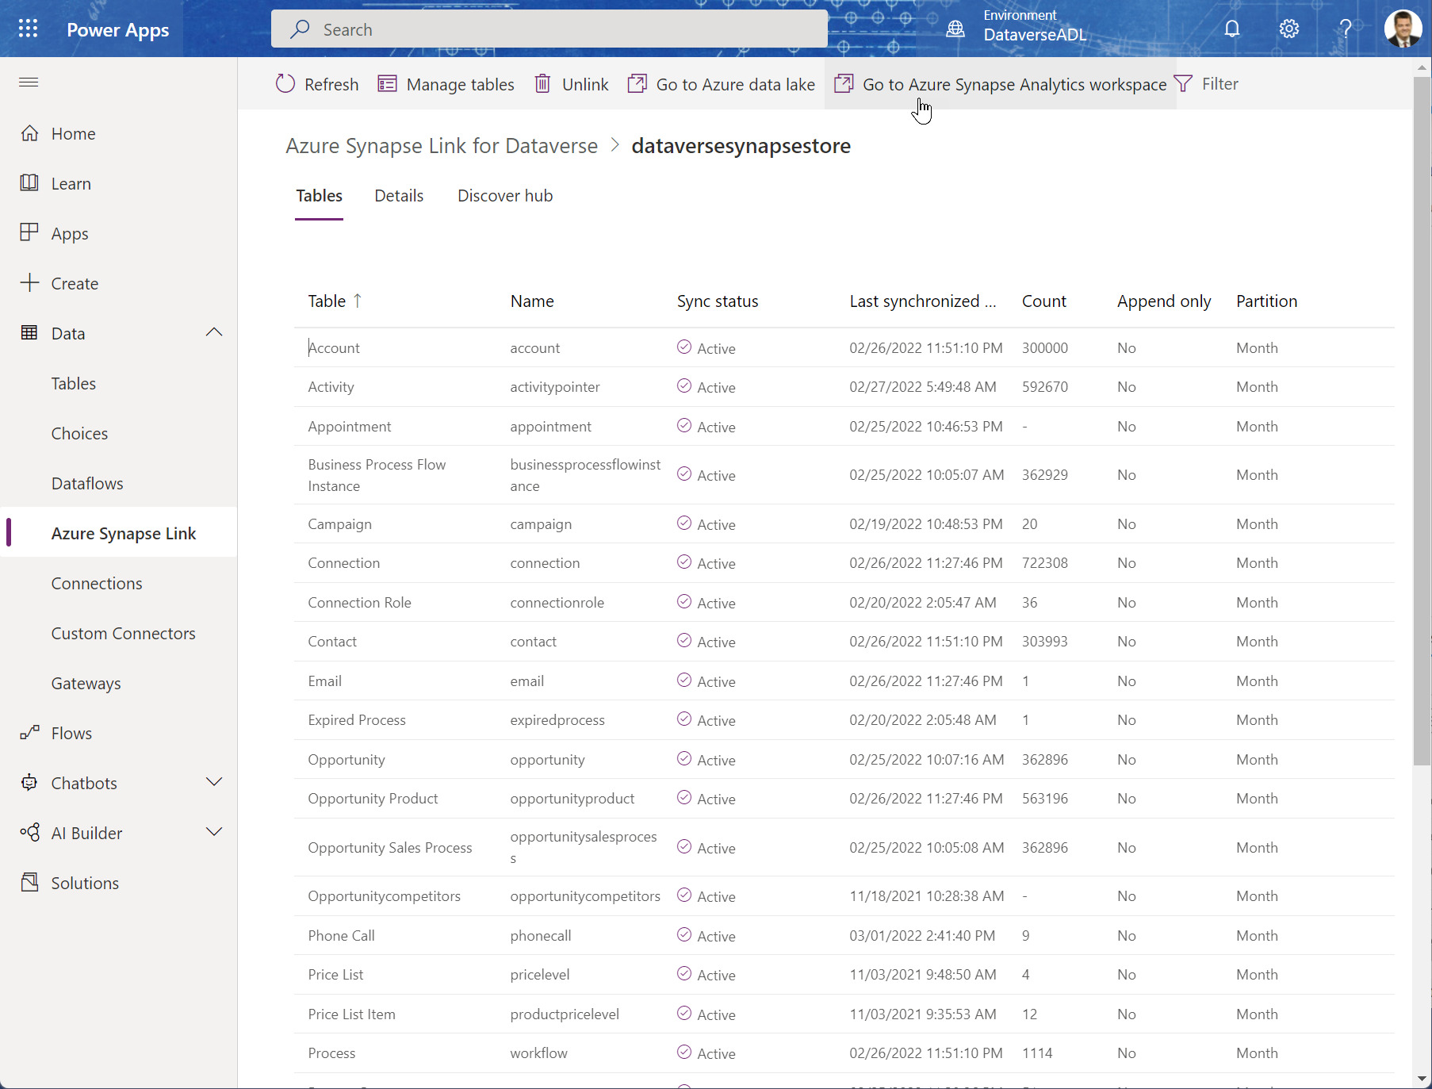
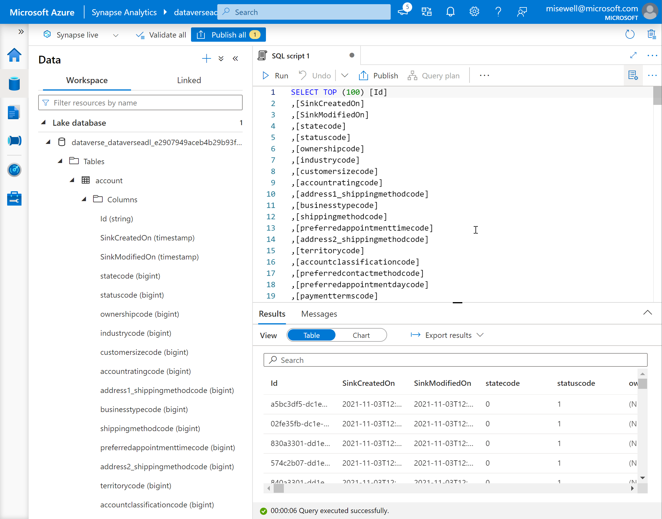
Open Synapse Workspace

Slide 45
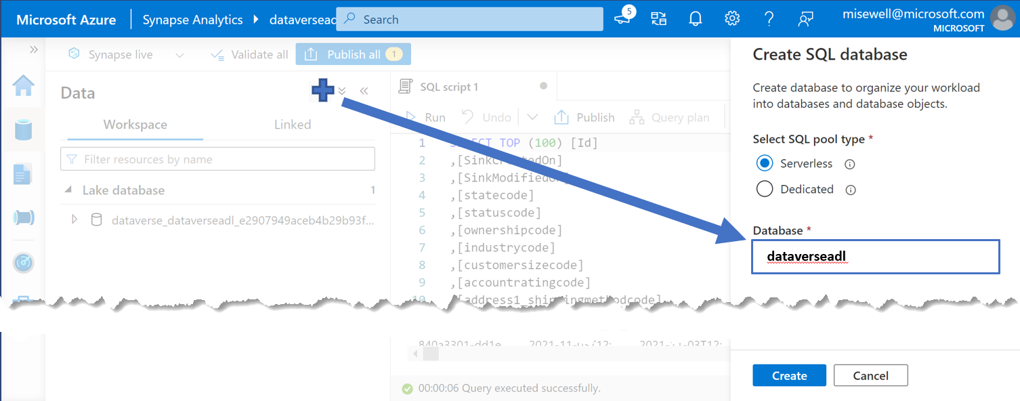
Create a companion Serverless SQL Database for Views
The ServerlessSQL DB auto-created by the Synapse Link is read-only.
Although you could point PowerBI directly to it, creating a 2nd ServerlessSQL DB to hold your own configured views for reports give you flexibility to create a simpler and ‘cleaner’ data source.
Azure Synapse Analytics – ServerlessSQL
Azure Synapse Link for Dataverse
Azure Data Lake Storage
Custom Report Views
Auto-Created Views

Slide 46
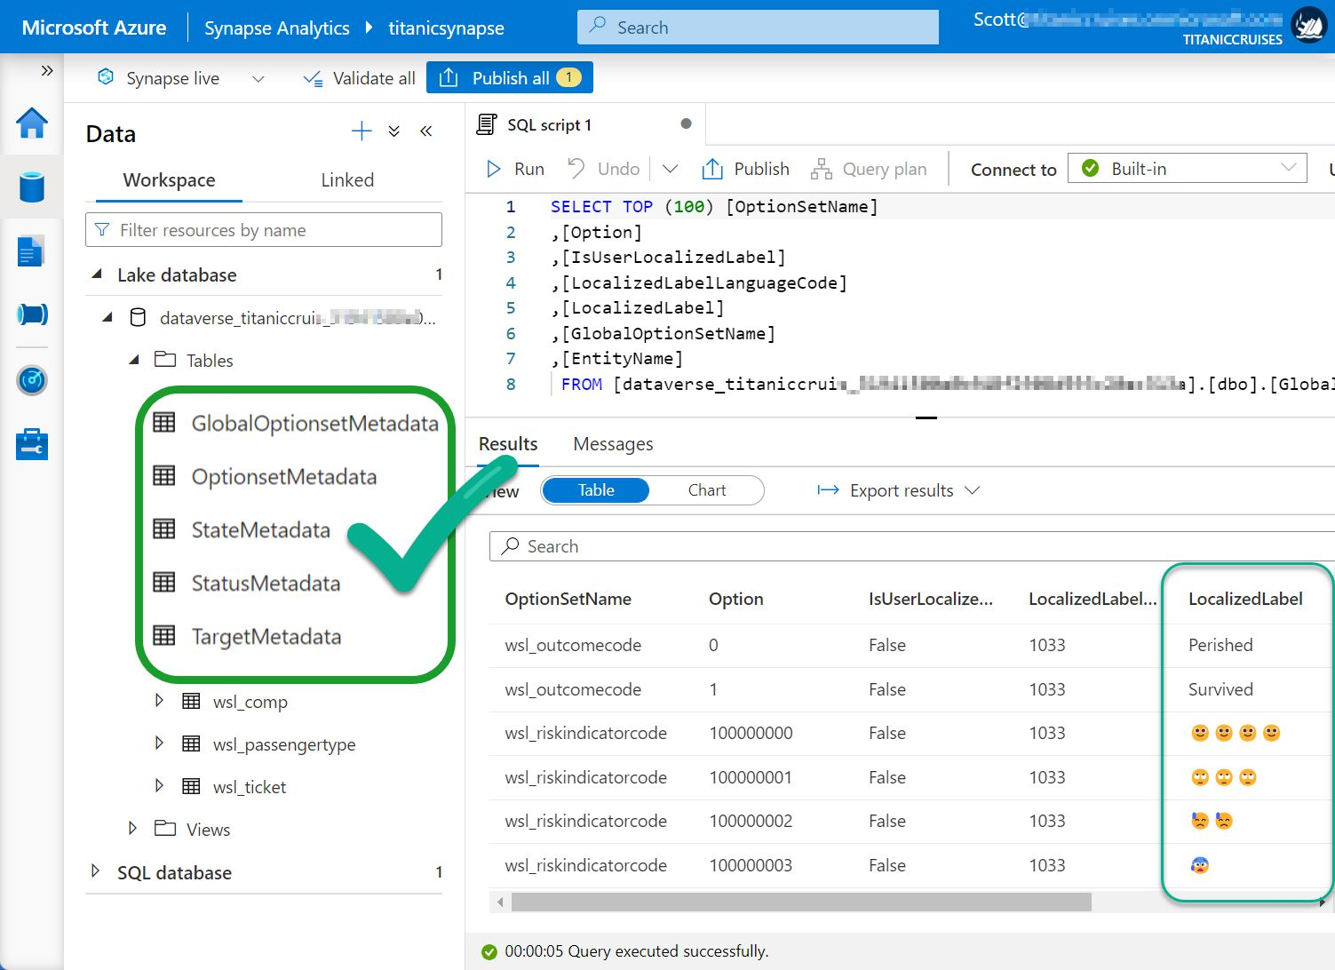
Use the metadata views to access the “Choice” Labels from Dataverse
The auto-created table views only return the numeric value associated with ‘Choice’ fields, State Code or Status Reason.
In a view, join the base table to the appropriate Metadata table to retrieve the needed label.
Documentation is here: Access Dataverse choice labels directly from Azure Synapse Link for Dataverse - Power Apps

Slide 47
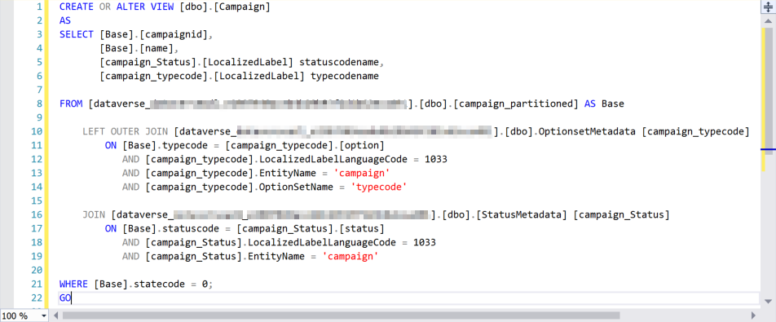
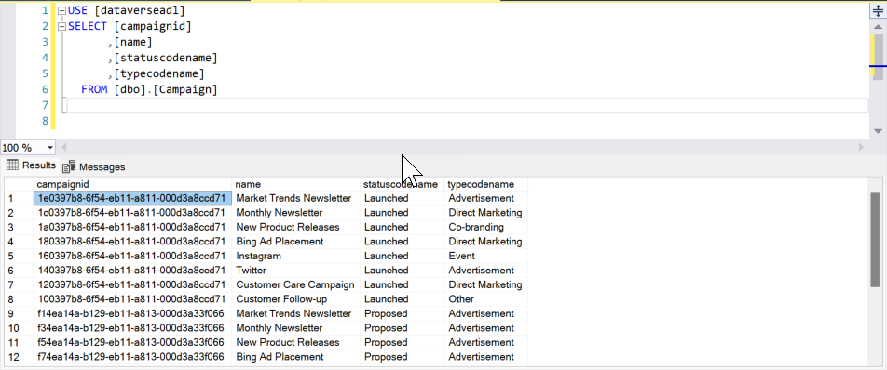
Create views for use as your report source.
Remove unneeded records and columns. Use the metadata views to resolve the choice labels and make it easier for your builders.

Slide 48
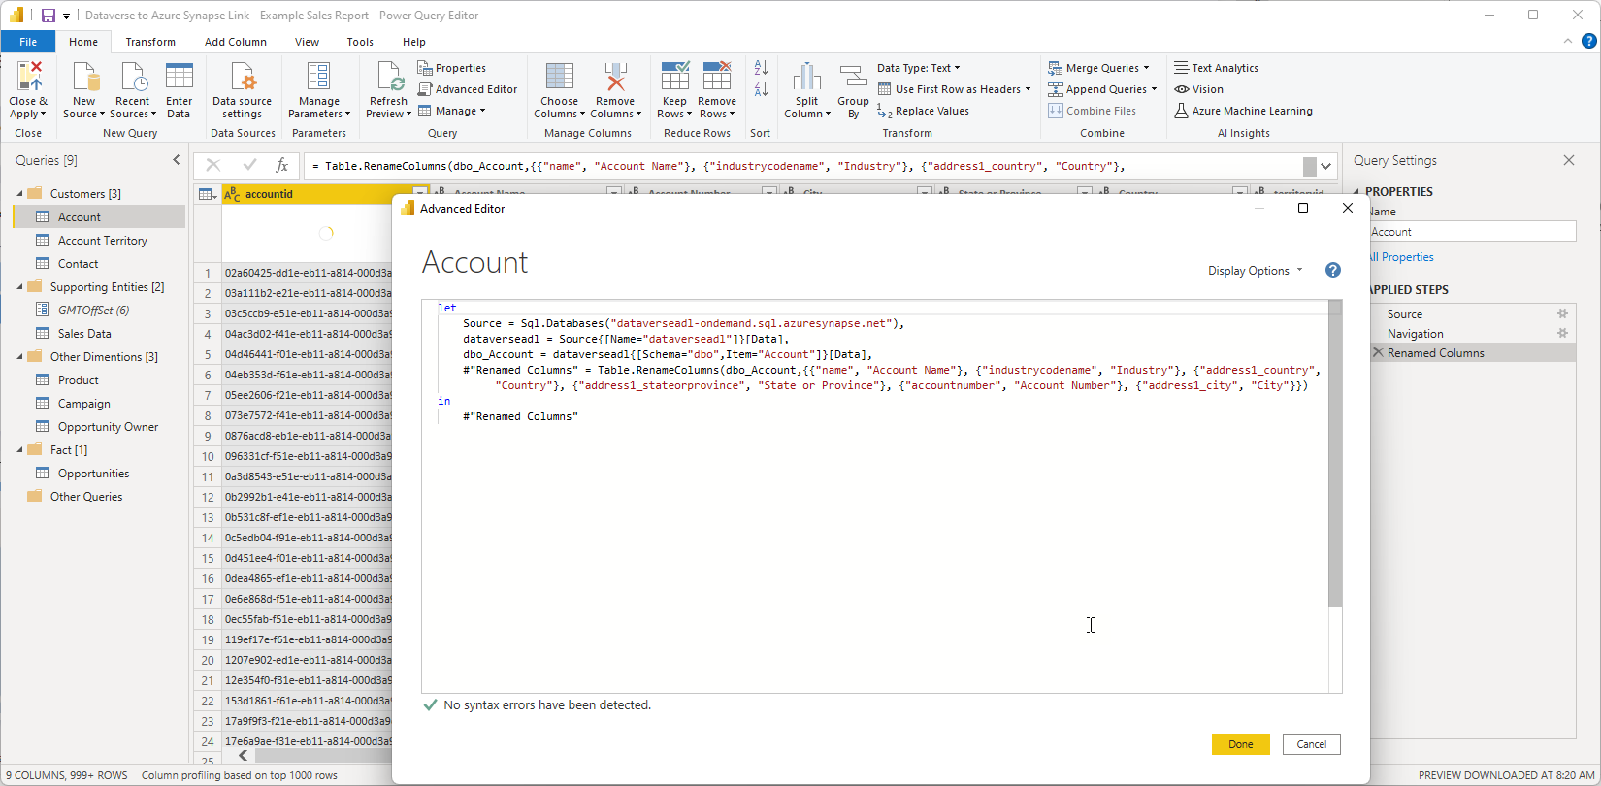
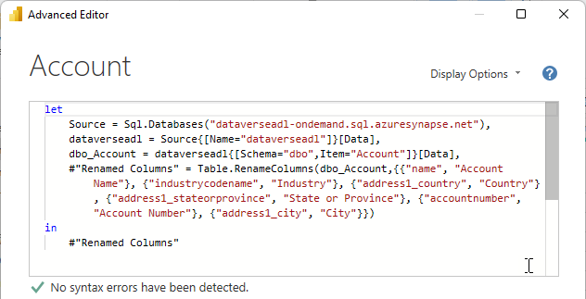
Connect Power BI to the newly created views

Slide 49

Completion of Basic Connectivity
Azure Synapse Link for Dataverse
Azure Synapse Analytics – ServerlessSQL
Auto-Created Views
Custom Report Views
Azure Data Lake Storage

Slide 50
Azure Synapse Link for Dataverse
Benefits:
Getting the Dataverse data to start flowing to the Azure Data Lake is a matter of clicks.
Considerations:
Azure Data Lake and Azure Synapse Analytics are billed on an Azure subscription.
Comes with a serverless SQL pool endpoint you can query with T-SQL.
Works as a data warehouse
Large volumes and complex query support in Synapse for additional data support and enrichment.
Once the data is out of Dataverse, the configured security model is lost (need to add Row Level Security).
If the customer hits Read/Write contention, there is a private preview for enabling an hourly snapshot for reading and other enhancements in the planning stage.
Date-Time is in UTC format

Slide 51
Q: Which connection is ‘right’ for my use case? A: It depends.
Criteria/Complexity
Dataset query result size | Dataverse – 80mb per Query | Azure Synapse – Massive
Query complexity | Dataverse – Power Query / SQL | Azure Synapse – Spark, SQL etc.
Data mash-up flexibility | Dataverse + Power Query | Azure Synapse Data Warehouse
Latency / Delay of data availability | Dataverse + DirectQuery Real time results | Azure Synapse Near Real-time or Hourly Snapshots
Effort to implement user context | Dataverse + DirectQuery Inherits Existing Security | Azure Synapse Row-Level Security in Power BI
Lower
Higher

Slide 52
Resources

Slide 53
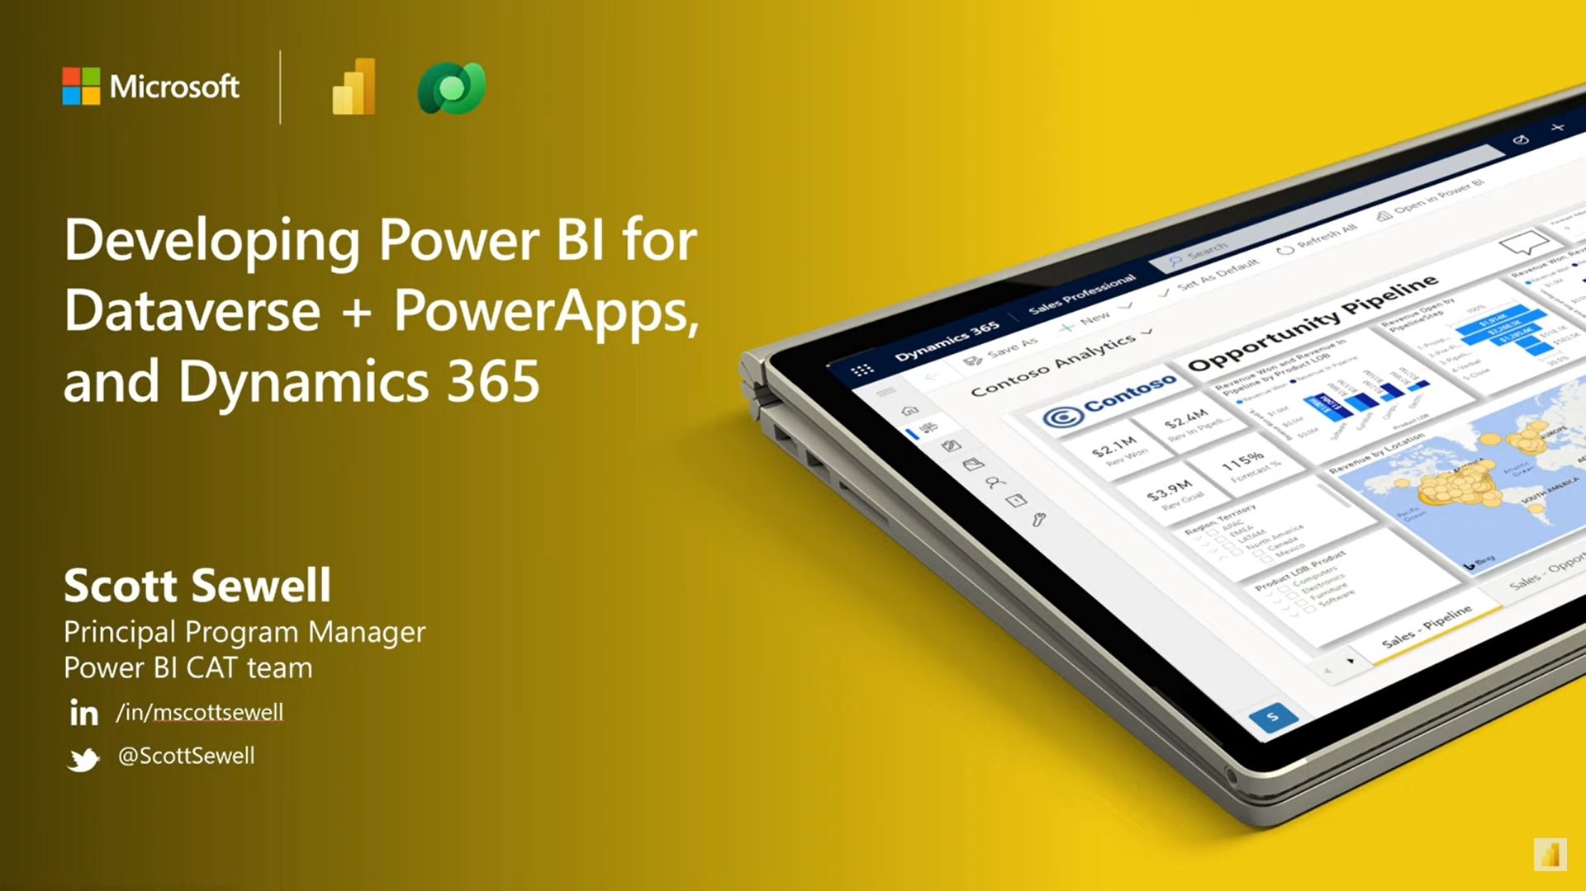
Developing Power BI for Dataverse + Power Apps
YouTube: Hands-on presentation for Power BI Dev Camp https://www.youtube.com/watch?v=9ZGpK2waM5Y
Power BI PBIX template reports https://github.com/PowerBiDevCamp/Camp-Sessions/tree/master/PBIX
PowerPoint deck: https://github.com/PowerBiDevCamp/Camp-Sessions/raw/master/Session%2014%20-%20Power%20BI%20with%20Dataverse.pptx

Slide 54
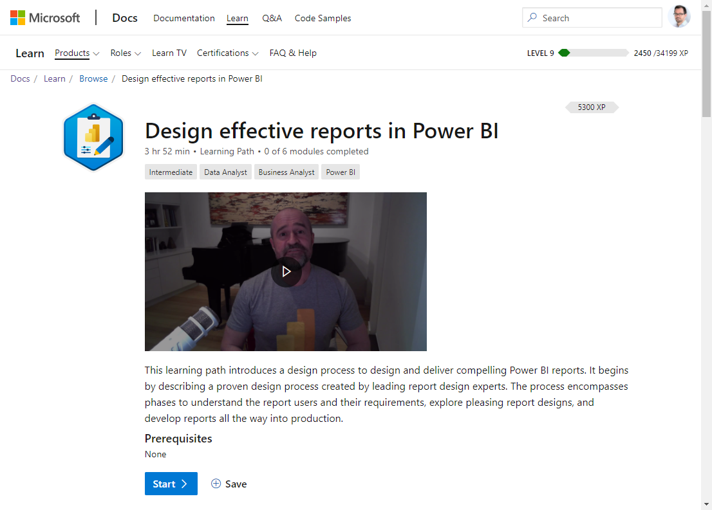
Microsoft Learn: design effective reports in Power BI
https://docs.microsoft.com/en-us/learn/paths/power-bi-effective/
Just like designers are rarely developers, developers are rarely aesthetically gifted designers – but delivering an un-designed (or poorly designed report) is almost never an effective result for the end-user.
The needed skill can be learned and applied by following a straightforward process to design and deliver compelling Power BI reports.
Proven design process created by leading report design experts.

Slide 55
Microsoft Docs
Use SQL to query data (link)
How Dataverse SQL differs from Transact-SQL (link)
Use Power BI with Dataverse
Overview (link)
View table data in Power BI Desktop (link)
Power Query Dataverse connector (link)
Embedding Power BI into Power Apps
Create or edit a Power BI embedded system dashboard (link)
Add or edit Power BI visualizations on your dashboard (link)
Embed a Power BI report in a model-driven app main form (link)
Power BI tile control in Power Apps (link)
Embedding Power BI into Dynamics 365 Finance and Operations apps
Analytical Workspaces (using Power BI Embedded) (link)
Power BI Embedded integration (link)
Customize embedded reports in analytical workspaces (link)
Power BI DirectQuery
DirectQuery model guidance in Power BI Desktop (link)
DirectQuery model troubleshooting in Power BI Desktop (link)

Slide 56
As a Dynamics/Power Apps/Dataverse Expert: Why should I care about this?
Expand the usability and value of your apps
Add a 360º overview for users / managers
Dataverse data – Without 50K row limits
External data – Combine without lift-and-shift
Contextual Reports
360º View from within an individual record
Your app becomes the go-to source.
Finally – The real benefit:
Dataverse is the best way to expose the value of the data in your app to Business Decision makers
Increase speed and completeness of adoption
Built-in Artificial Intelligence over your data

Slide 57
Thank you! https://github.com/mscottsewell/PowerBI-Dataverse

